Slide 1

WRITING ESSAYS
for
COLLEGE ADMISSIONS & SCHOLARSHIPS
Presented by:
Regina Harden

Slide 2


School Research
Most US colleges and universities require applicants to write a short essay about themselves or a specific topic as part of the application process. The essay gives you an opportunity to talk clearly about your goals, and can give admissions officers a better idea of how well you might fit in with the school.
Check the college admissions page – is the essay required?

Slide 3

Getting Started
#readysetgo

Slide 4


It really is
ALL ABOUT ME!
What characteristics are colleges looking for in applicants?

Slide 5


What am I writing about?
The best essays are about something simple, yet meaningful.
The reader wants to know who you are, not what you've done.
What is one thing that I want people to know about me?

Slide 6


Table Topics Activity
#ideaSTARTERS
Keep a journal
Interview family and friends – about you!
What items in your room really define you?
What makes something ‘your favorite?’
What can you talk about for hours?
What has your journey been so far?
How has your illness made you stronger?
What are your super powers?

Slide 7

The essay is the narrative!
Once you have chosen a topic, think of a specific story to write about.
Instead of listing the various activities you were involved in, pick one activity and show the reader who you are and what you've learned from it.
Remember – who is telling this story. You are the narrator!

Slide 8
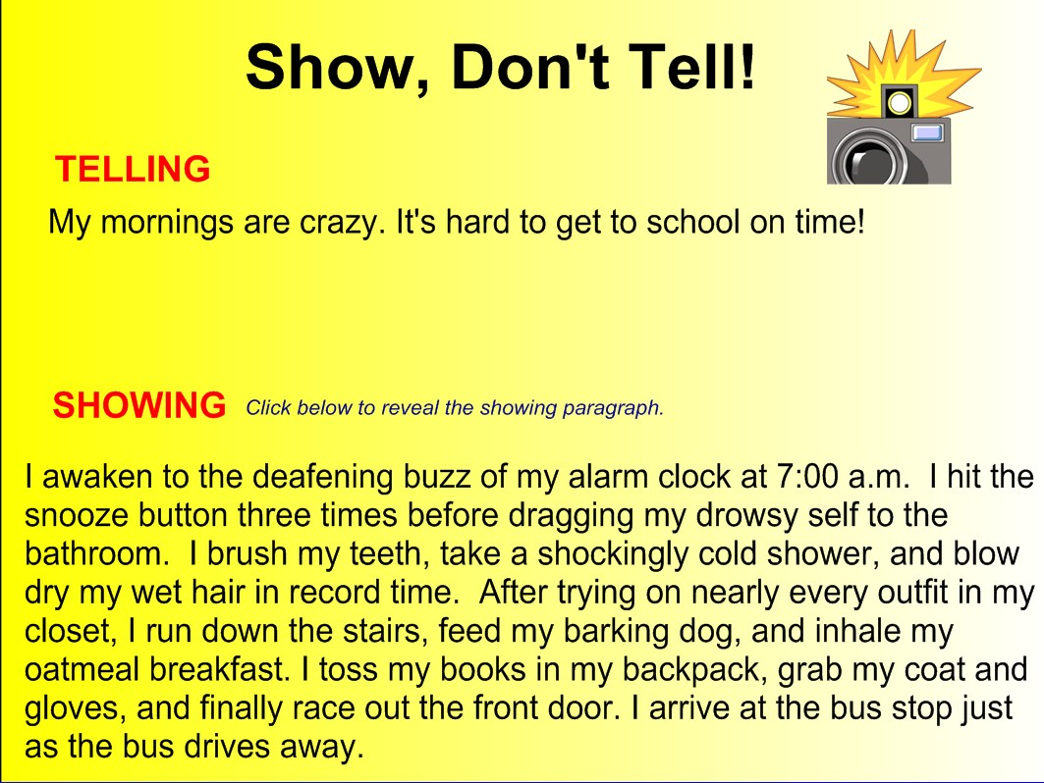

Slide 9
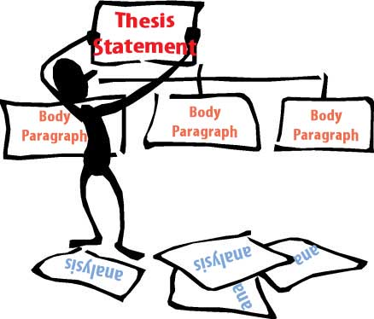
ACTUALLY WRITING THE ESSAY
#thebasics
Word count varies 650 - 1000
Essay structure
Grammar and spelling checks
What is the main point (thesis)?
Is there a clue to the main point in the introduction?
Did I use figurative language/imagery to ‘show’ not ‘tell’ ?
Did my essay conclude with main point?
Did the reader learn anything about me?

Slide 10
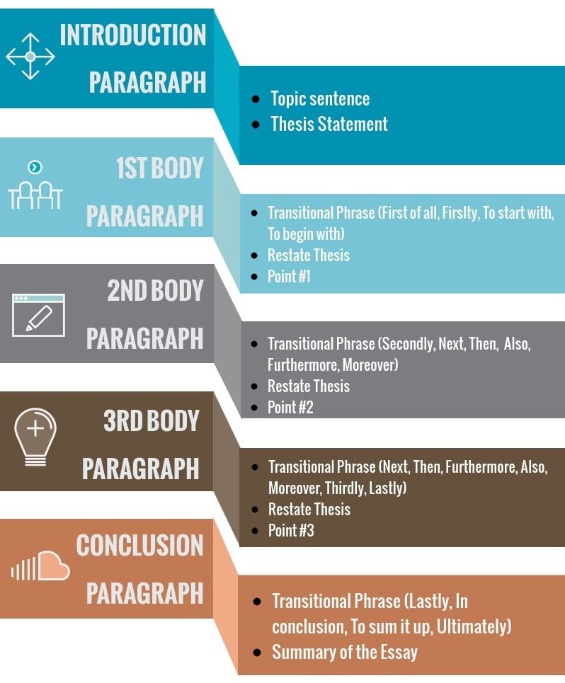

LET’S START WRITING

Slide 11
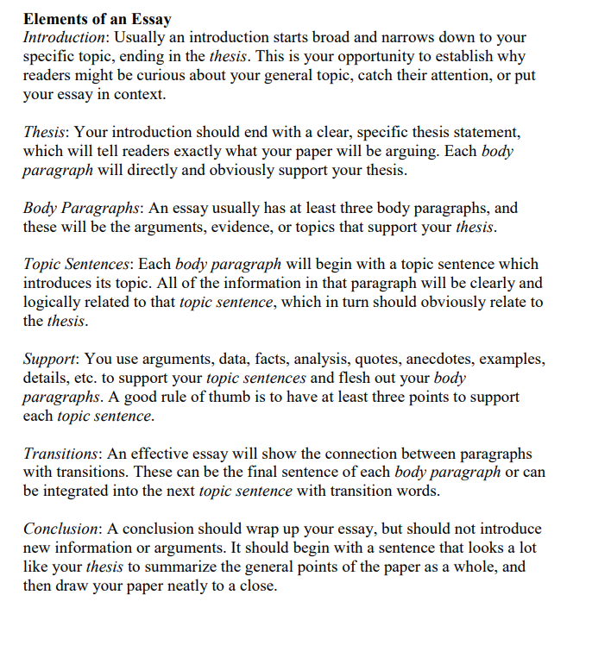

LET’S START WRITING

Slide 12
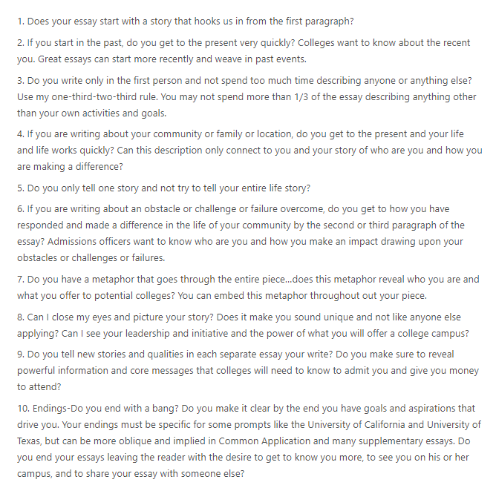

CHECK YOUR WRITING

Slide 13
Presented by:
Regina Harden
WRITING ESSAYS
for
COLLEGE ADMISSIONS & SCHOLARSHIPS

